Slide 1
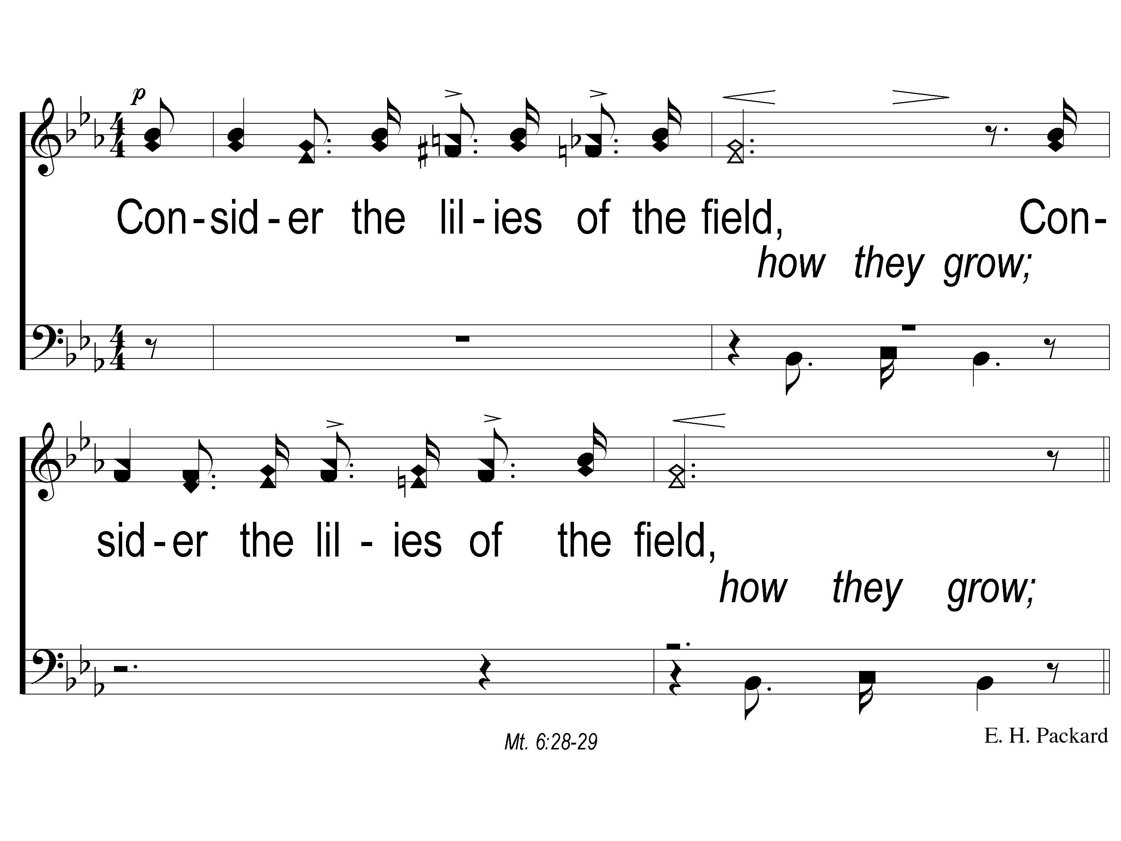
1 Consider the Lilies
Consider The Lilies
73
ePraise Hymn Presentation © 2005 Taylor Publications

Slide 2
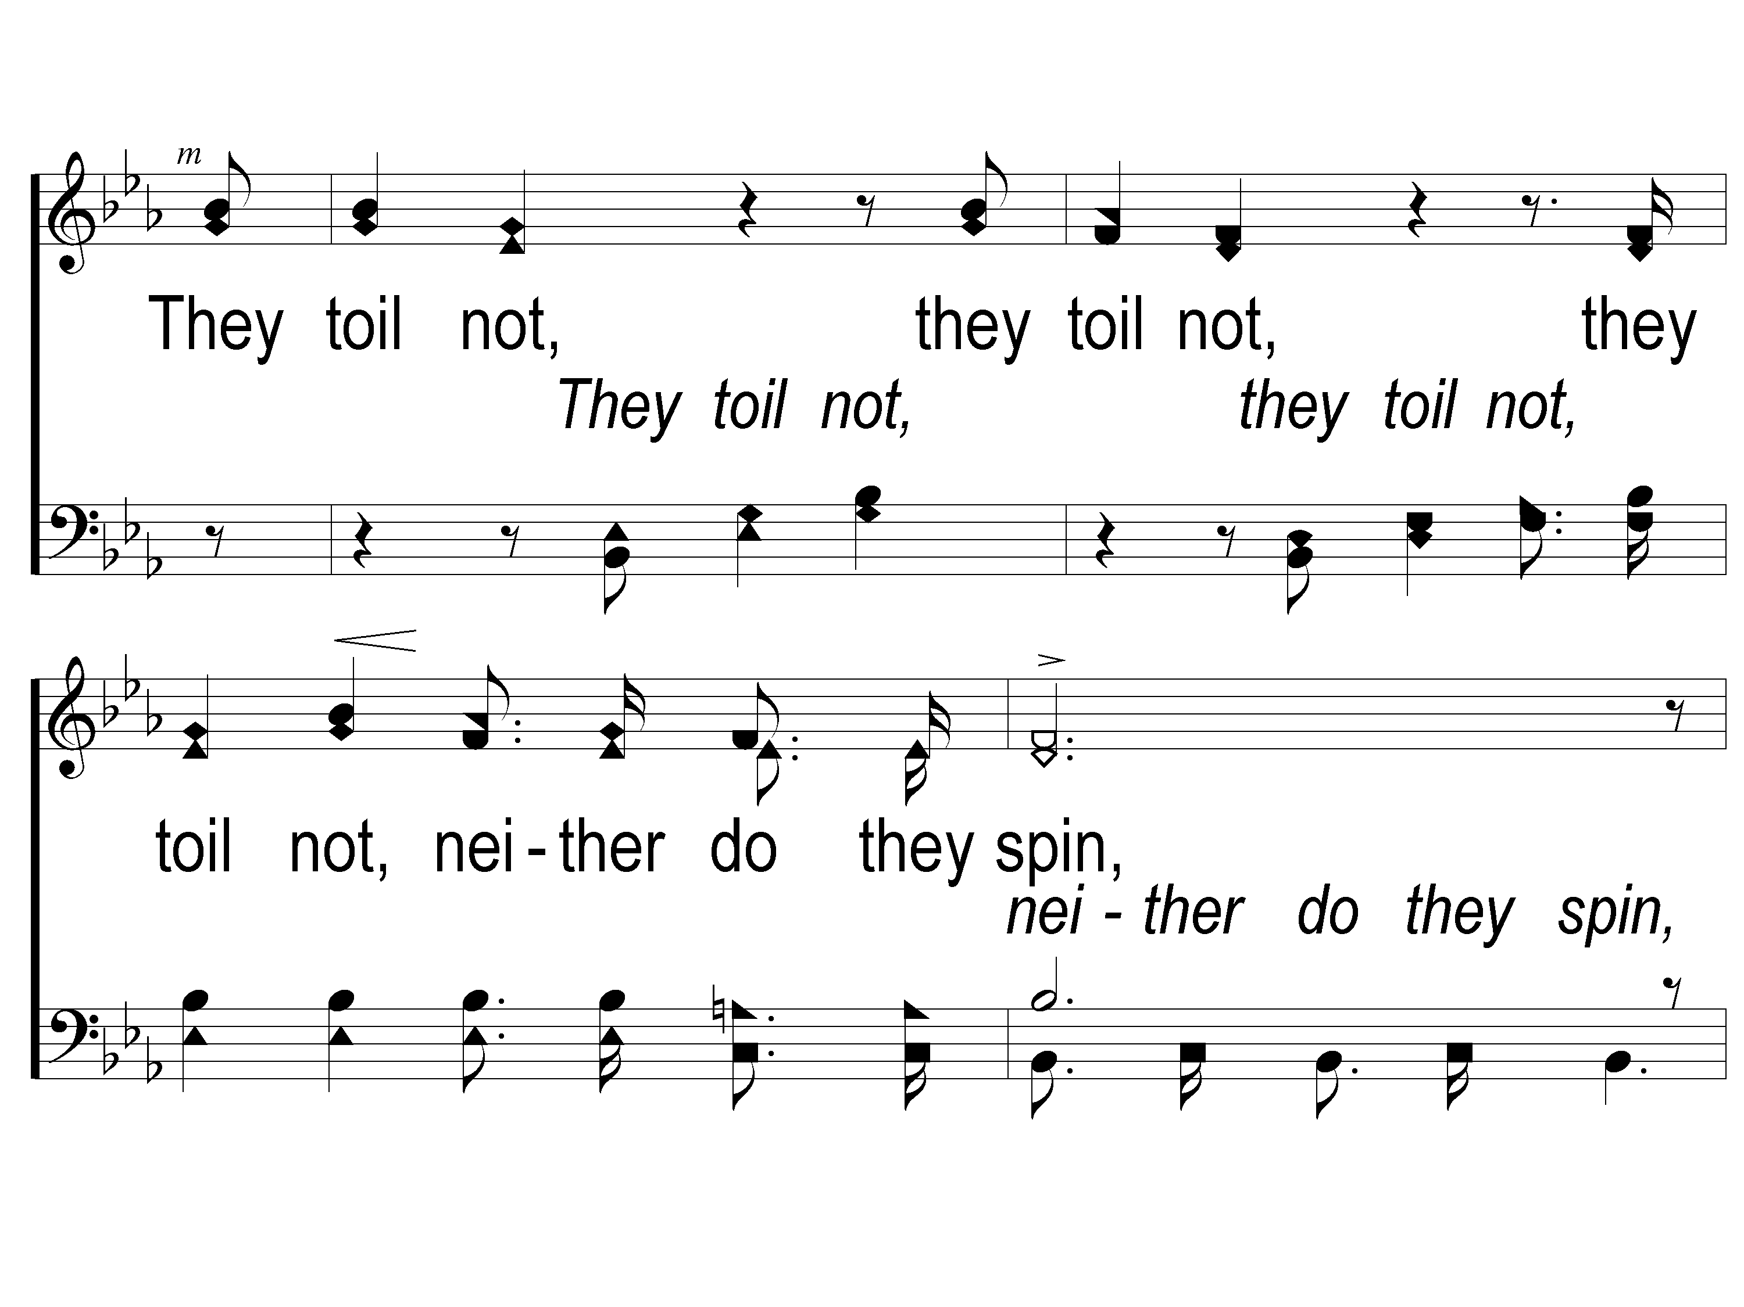
2 Consider the Lilies
Consider The Lilies
73
ePraise Hymn Presentation © 2005 Taylor Publications

Slide 3
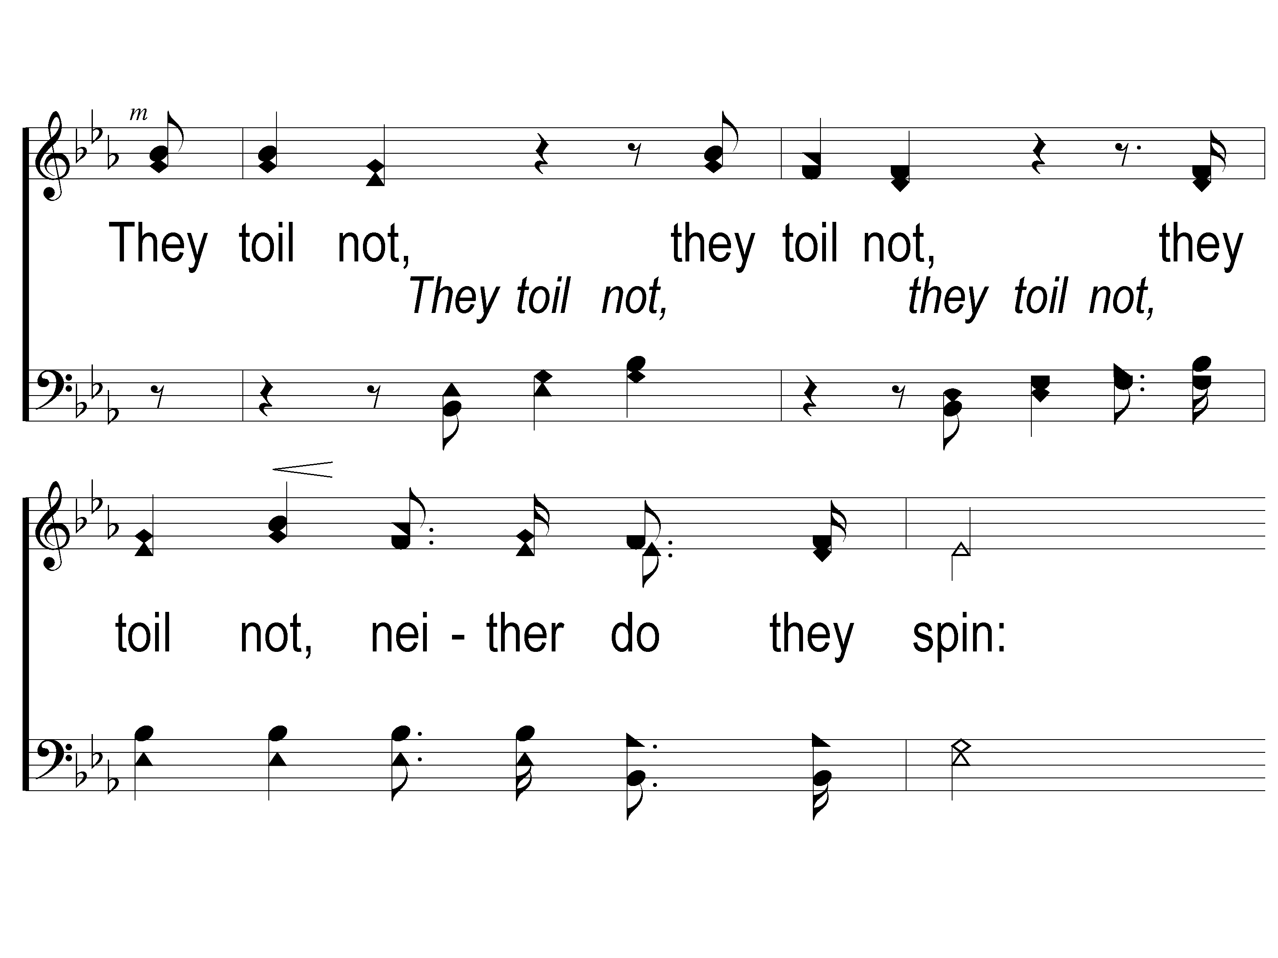
3 Consider the Lilies
Consider The Lilies
73
ePraise Hymn Presentation © 2005 Taylor Publications

Slide 4
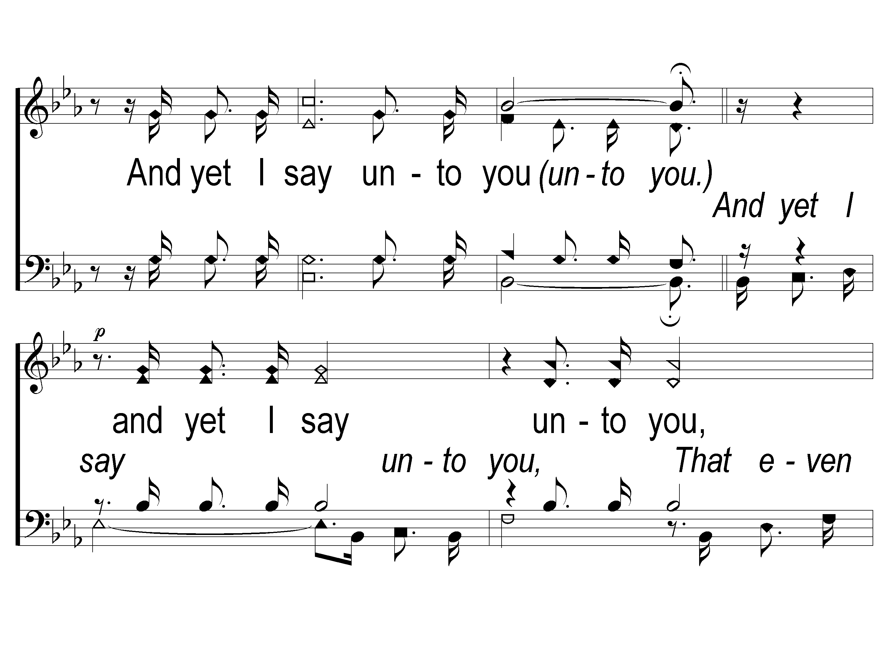
4 Consider the Lilies
Consider The Lilies
73
ePraise Hymn Presentation © 2005 Taylor Publications

Slide 5
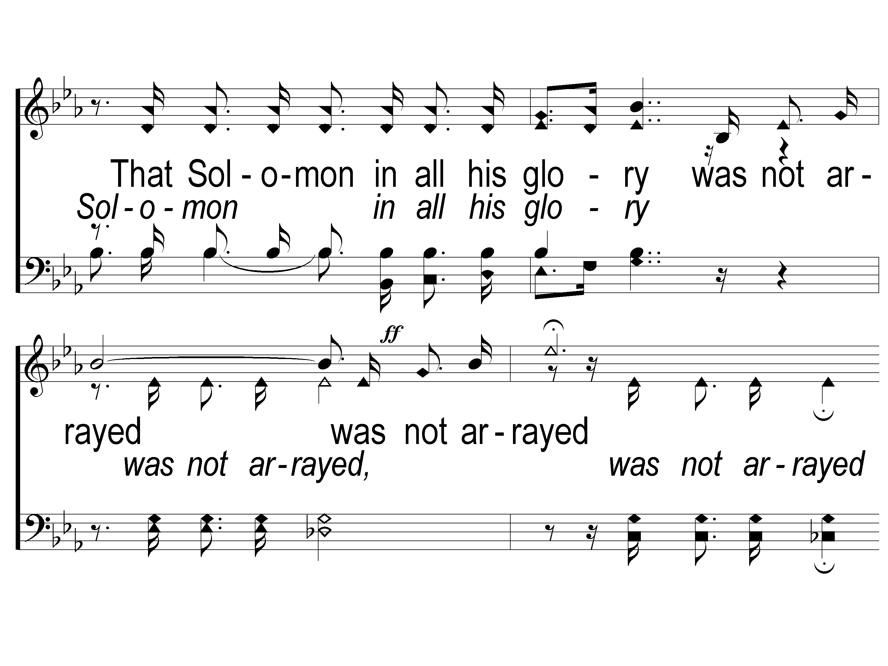
5 Consider the Lilies
Consider The Lilies
73
ePraise Hymn Presentation © 2005 Taylor Publications

Slide 6
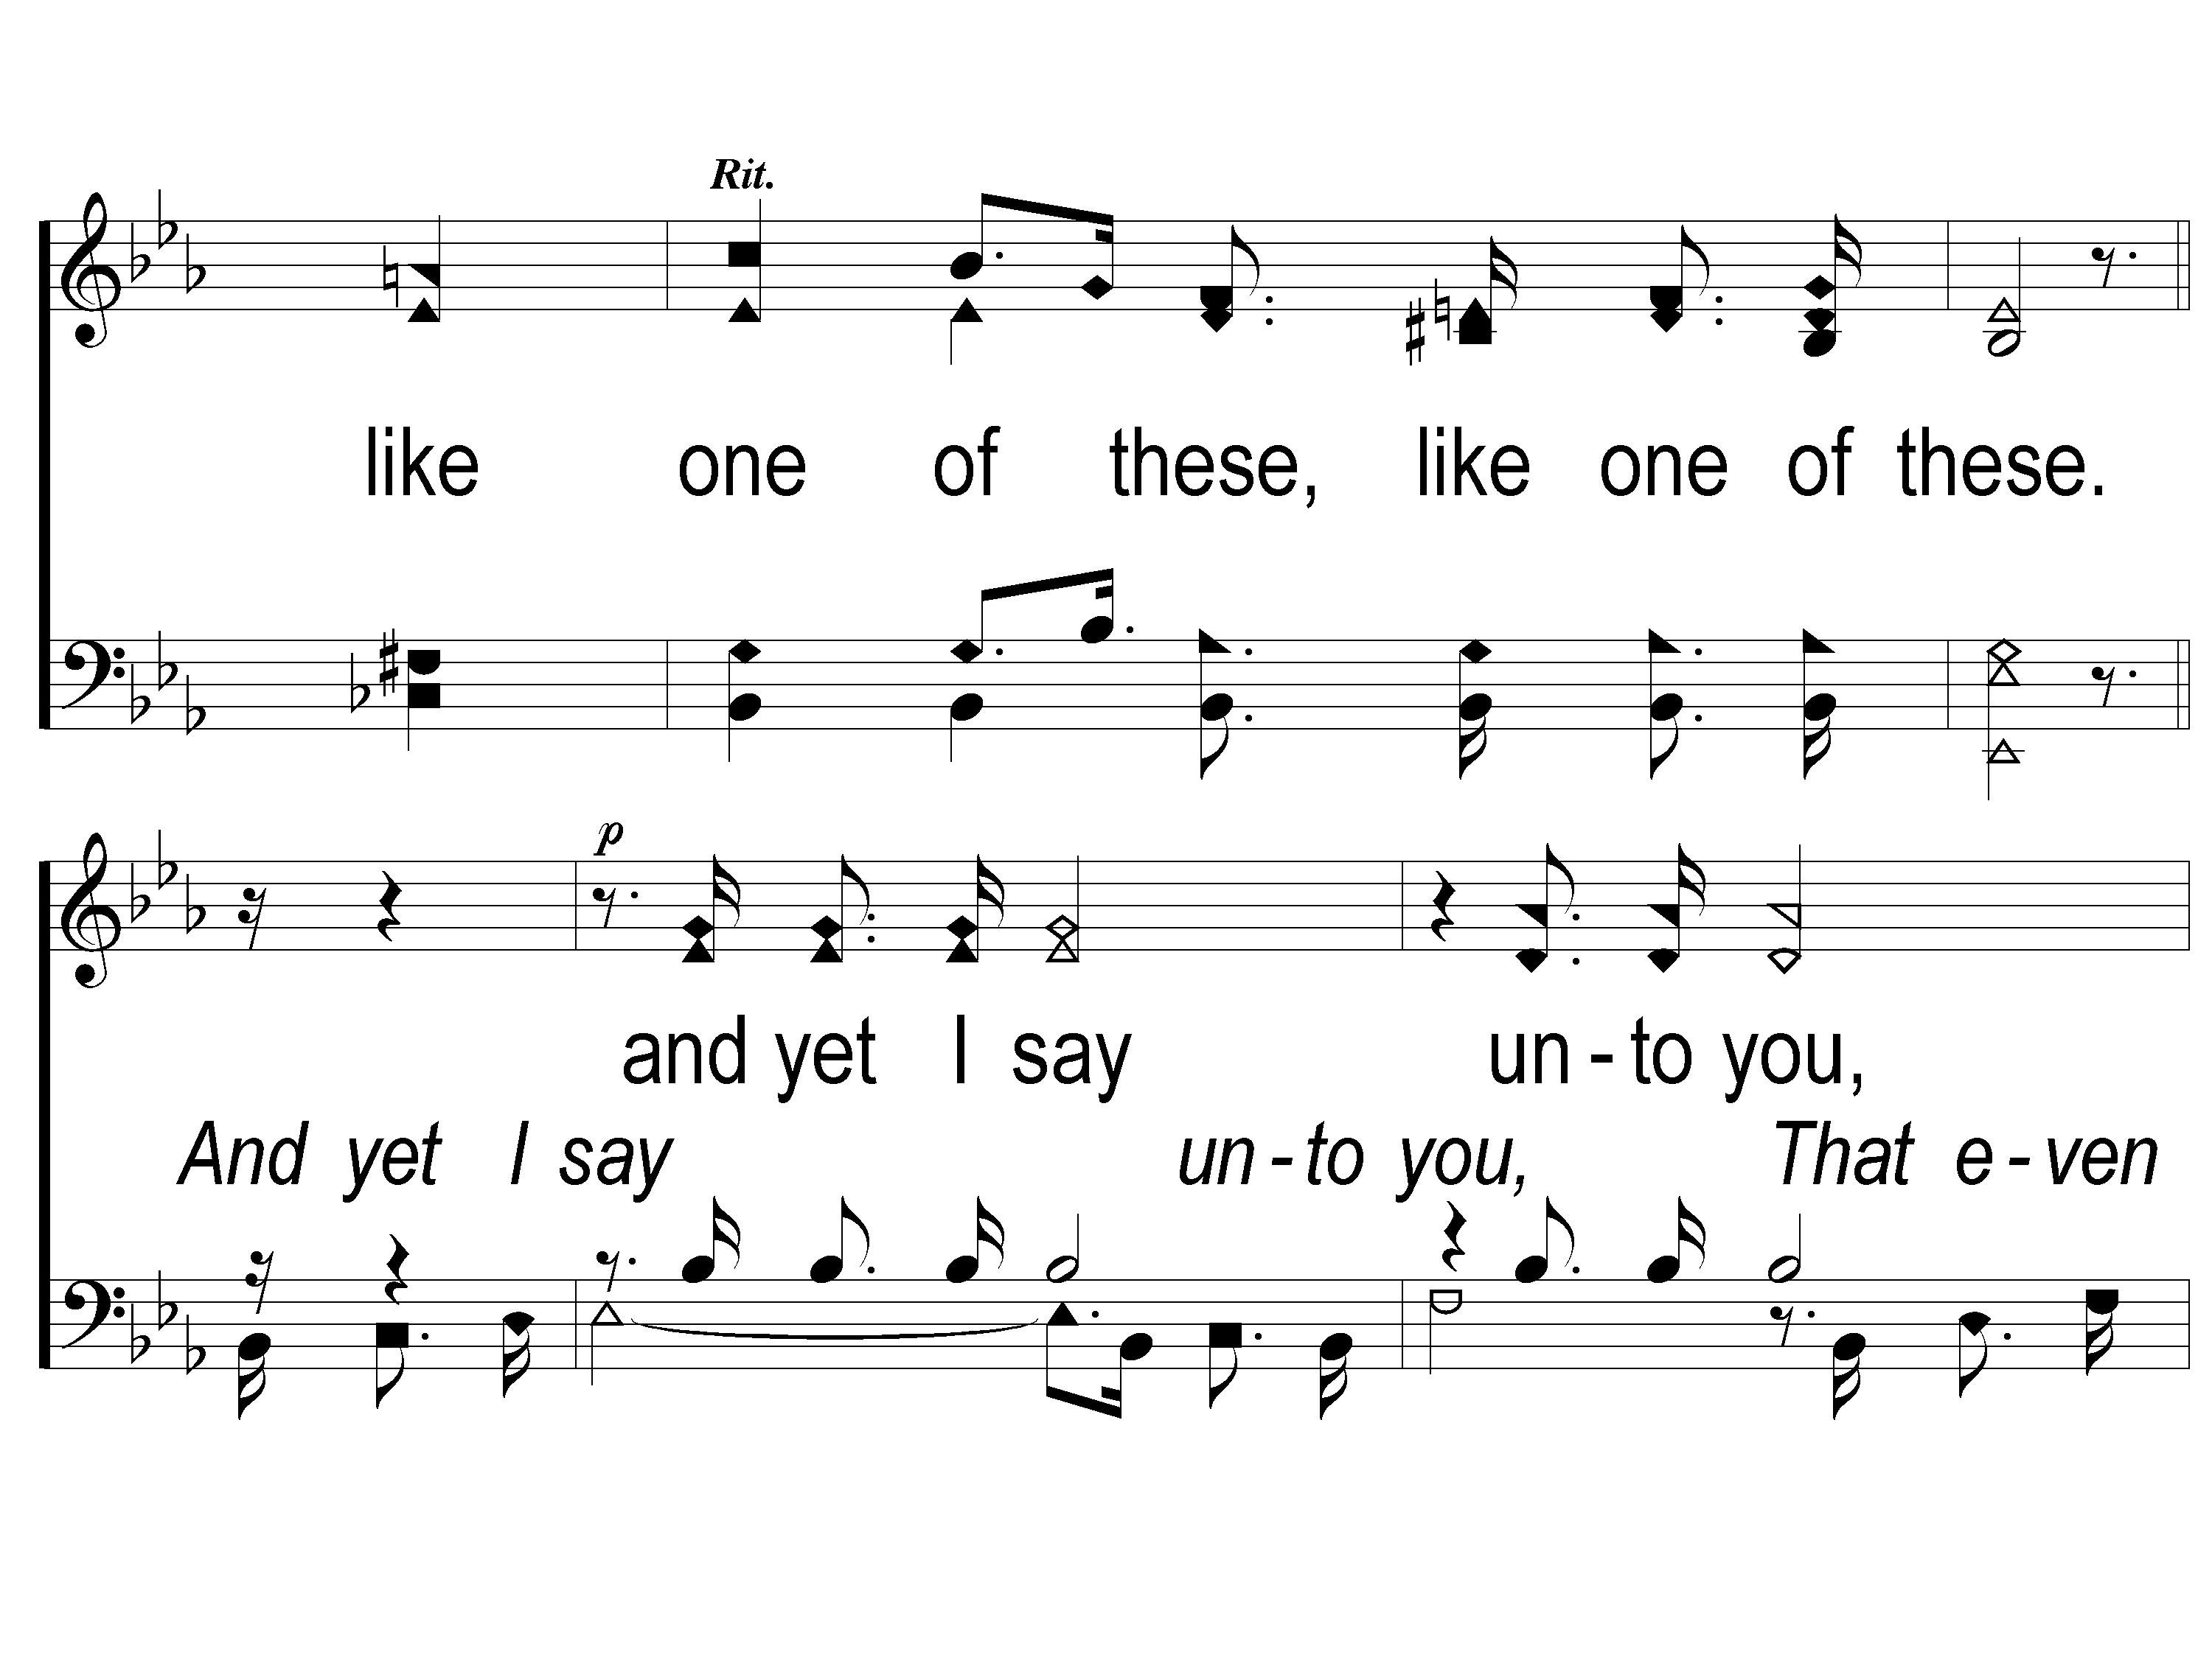
6 Consider the Lilies
Consider The Lilies
73
ePraise Hymn Presentation © 2005 Taylor Publications

Slide 7
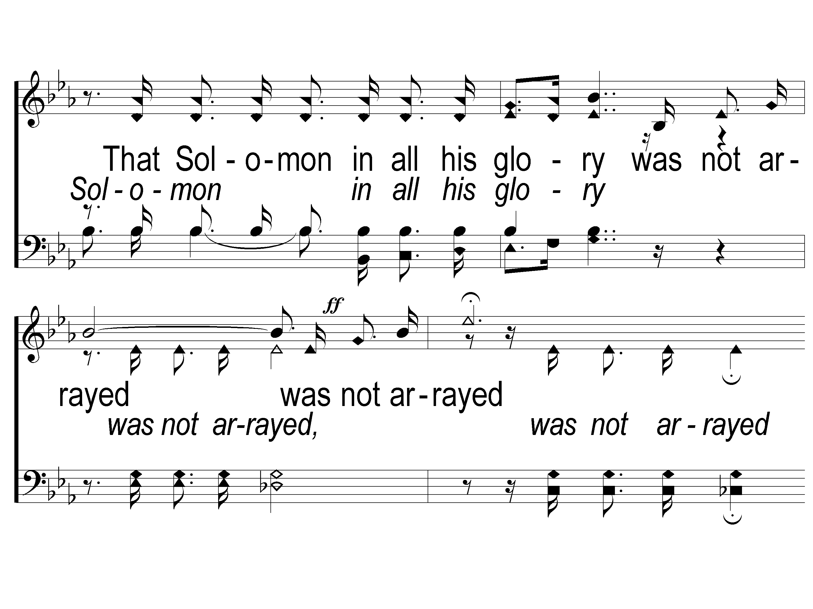
7 Consider the Lilies
Consider The Lilies
73
ePraise Hymn Presentation © 2005 Taylor Publications

Slide 8
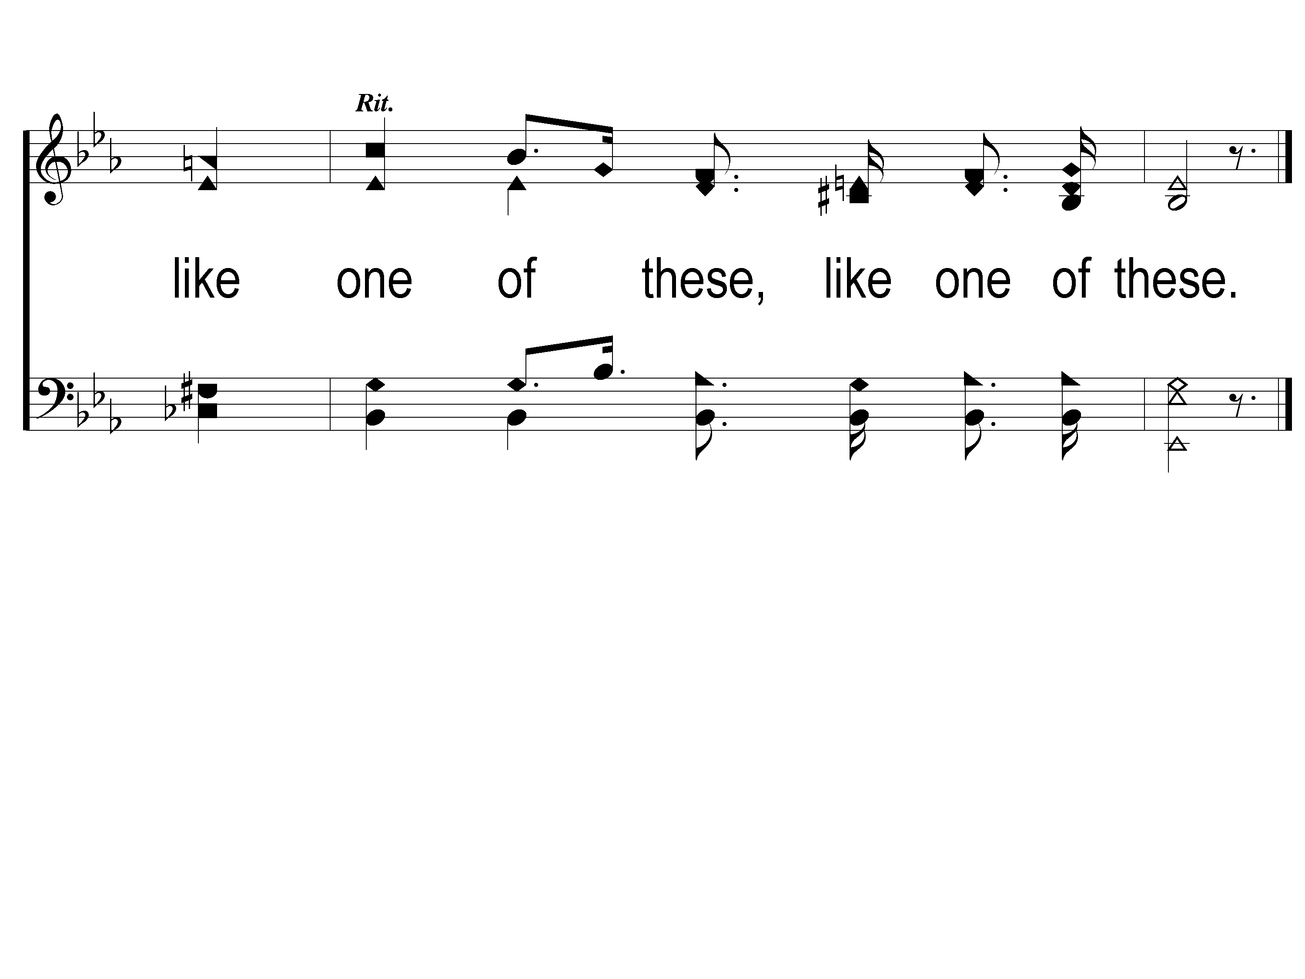
8 Consider the Lilies
Consider The Lilies
73
ePraise Hymn Presentation © 2005 Taylor Publications

